Slide 1
Classical Planning
Planning Under Uncertainty
Markov Decision Process
6CCS3AIP – Artificial Intelligence Planning
Dr Tommy Thompson
Notes:
Hello and welcome to this new segment on planning under uncertainty. In this chapter we’re going to give a brief overview of the challenge at hand and what problems this presents for our planning approaches.
Now this is not going to be a complete overview of this particular issue. However, the bulk of the material in this module does not factor in issues of uncertainty. Hence it was important for us to spend a little bit of time talking about to some degree and how it means we don’t use the same search processes as before. For those of you notably studying topics such as reinforcement learning, you’re going to see where these two fields overlap and why reinforcement learning can prove highly effective in specific situations.

Slide 2
Classical Planning: Material Overview
Classical Planning: The fundamentals.
Improving Search
Heuristic Design (RPG/LAMA)
Dual Openlist Search
Optimal Planning
SAS+ Planning
Pattern Databases
Non-Forward Search
Graphplan
SAT Planning
POP Planning
HTN Planning
Planning Under Uncertainty
Notes:
So as we return to our overview. The theoretical side of the module has looked at different ways in which planning is impacted by different approaches or problems. This includes how to improve the basics of our heuristic design and search process. How we can move towards optimal planning by changing our formalisms and techniques for helping us find good actions as effectively as possible. And more recently looking at non-forward search and the idea that we don’t always have to adhere to the more traditional notion of forward search from the initial state.
So to get into this topic, let us once again return to first principles…

Slide 3
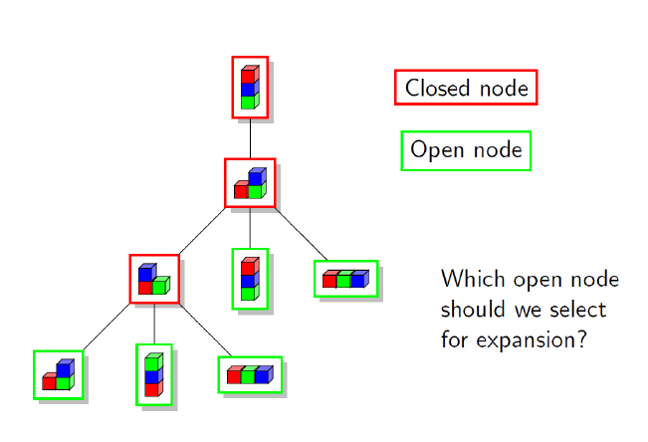
Fundamentals: Forward Search
Definition of the problem – PDDL
Forward Search
Breadth/Depth First
Introducing Heuristics
Best First Search/A*
Notes:
Going back to my introductory chapter, everything we have done in the module to-date has revolved around the notion of the state space and search. We have our PDDL, it helps us establish what the search space is and then we use simple forward search or potentially something more intelligent some as Best-First or A* to move through the space.
Now, all of this relies on one fundamental assumption, the state transition system. We assume that when we are in a given state and we can then expand it into a subsequent state. What happens when these rules start to breaK?

Slide 4
Planning Under Uncertainty
Issues that can arise include…
We might not know which state we are in.
i.e. Partial observability
We don’t know if actions will succeed as intended.
i.e. Non-Deterministic Actions
Actions might not execute as intended, resulting in possible new effects.
i.e. Non-Deterministic Effects
Notes:
So we have always ran on the assumption that we know what state we are in. But what happens if – due to the nature of the problem – we don’t know for sure what state we are in.
There might be some uncertainty about information in the state, meaning that we could potentially be in two or more different states at the same time. Given we’re aware of this uncertainty, what action should we be taking in this instance?
Secondly, there is the issue of whether an action completes as intended. We have always assumed that the state transition system is deterministic. Meaning that if we apply action a at state s, we will always get the resulting state s’. So, what happens if we now have actions for which you don’t know the outcome? It could be multiple possible outcomes of the same action. Resulting in non-deterministic actions, meaning we don’t always know how the action is going to turn out.
Lastly, what if an action is non-only non-deterministic, but also has the capacity to result in effects that only occur in certain circumstances. This results in non-deterministic effects, where it could be – that with a certain probability – we result in a different set of add or delete effects, based on the outcome of the action.

Slide 5

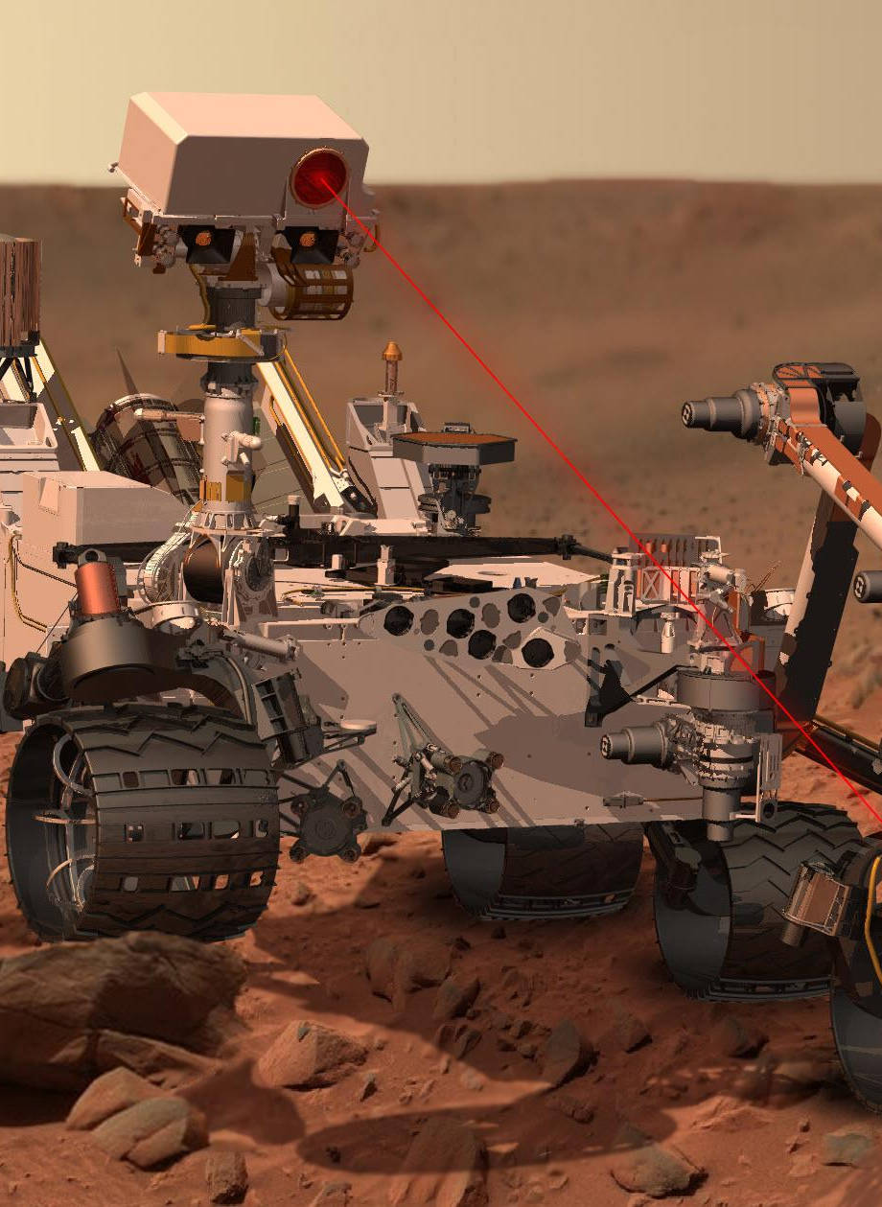

Why is this important?
“The best laid schemes o' mice an' men / Gang aft a-gley.”
“To a Mouse”, Robert Burns, 1785
Notes:
Now I can assume that many of you are watching this and are grateful this is acknowledged. But – for the sake of argument – it’s important to acknowledge how important this is.
Uncertainty is rife within any example of planning in the real world.
To quote the Scottish bard Robert Burns in his poem in “To a Mouse”
“The best laid schemes o’ Mice an’Men, Gang aft agley.”
What that means in English, is that no matter how carefully prepared you are and how much you plan for how to something will go, there’s still a good chance that something will go wrong with it.
And this occurs a lot when doing with real world systems and mechanisms. Sensors might misread, motors can fail, components might be faulty. Hence there is a very real concern of how to address plans in a way that helps us maintain certainty in an uncertain world.

Slide 6
Classical Planning = No Uncertainty
$$s7$$
$$s4$$
We assume the state is known.
We assume all states in the problem are known.
We assume that we know all actions from the current state.
We assume that a given action will always execute as intended.
We assume that the successor states of action execution are also known.
$$s8$$
$$s2$$
$$s5$$
$$sg$$
$$si$$
$$s9$$
$$s3$$
$$s6$$
$$s10$$
Notes:
To more effectively summarise how uncertainty is not handled in classical planning, there are five main topics that come to mind.
First of all that we assume we know the current state, the world is fully observable and therefore I can say with absolute certainty that I know I am in a given state.
The second point is a continuation of the first, in that we know every single state that exists in the problem. Or rather that our formalism for the state will ensure we can find every possible state if we wished to exhaustively explore the entire search space.
If we consider actions, we assume that all actions from the current state are known, and that is largely down to our assumption of the state. Given if we know the state, then we can say with confidence what action preconditions are being satisfied.
Our fourth and fifth points relate to the execution of actions: given we assume that an action will always execute as intended but also that the successor state of the action is a given. We know how this is going to turn out if we say in BlocksWorld pick up a given block with the gripper.

Slide 7
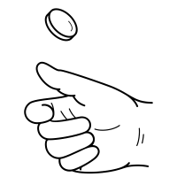
Classical Planning = No Uncertainty
We assume the state is known.
We assume all states in the problem are known.
We assume that we know all actions from the current state.
We assume that a given action will always execute as intended.
We assume that the successor states of action execution are also known.
Notes:
Now in order to start exploring this topic, I’m going to begin with these latter points, of knowing how actions will pan out. Given this is – not necessarily easier to solve – but is less complicated to manage and arguably our first step towards handling uncertainty.
And to get you in the right head space, let’s talk about something really simple: a coin toss.
Tossing a coin is – by its very nature – an action that has single pre-determined result. It’s why we toss a coin in specific situations, because we know it will result in one of two possible outcomes (provided of course it’s not a one sided coin and that you toss it successfully).
Right now we have now means of capturing this in our planning processes. We simply assume that the state space is deterministic. That by if we were to toss that coin, it would always result in one side facing upwards.
So how can we more effectively encapsulate the idea that an action does not necessarily result in the same outcome each time?

Slide 8
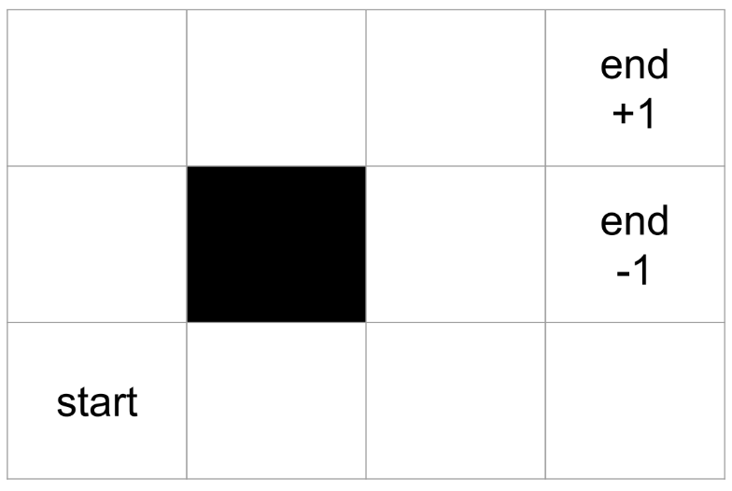
Example
Navigating in a maze.
Simple to solve using uninformed or heuristic-driven search.
But immediately becomes more challenging when the problem space is not deterministic.
Notes:
So consider this example here, where we have a problem space whereby we start in the bottom left corner of the world, and there are two goal states, each with a utility value of +1 or -1.
Ideally we want to find the goal state with a utility of 1. The actions you have are to move in any valid direction from the current cell, so if you’re at start, you can move up or right. Attempting to move left or down would fail in this instance given those are the environment boundary, plus the back square in the centre is a wall and is blocked from navigating through.

Slide 9
Example
Navigating in a maze.
Simple to solve using uninformed or heuristic-driven search.
But immediately becomes more challenging when the problem space is not deterministic.
Notes:
Now if we use A* with a simple distance to goal heuristic (either using Manhattan or Euclidean distance), then the path to an optimal solution is very easy to find. In fact, there are two optimal solutions, with the red and yellow paths splitting at the initial state and then coverging at the position left of the goal state, where they both take the same action denoted in orange.
In fact, even using something like breadth-first search will find the answer to this question. And while it would be more demanding if the search space was any bigger, it’s still easily solvable.
So let’s break this problem in a very simple way, by making the actions non-deterministic.

Slide 10
Example
Non-deterministic actions mean that the state transition system is no longer consistent.
0.8
0.1
0.1
Notes:
So let’s add some randomness to the problem, by stating that in any state, any action applied only has an 80% success rate. But there’s a 10% chance you’ll go either direction at right angles to your current heading – all of this assuming that those directions are not blocked of course.
So 80% of the time if you intended to move up, you’ll move up. But 10% of the time, you’ll go left and another 10% of the time you’ll go right.
Similarly, if you intended to move right, you’ll move right 80% of the time, up 10% of the time and down 10% of the time.
So now there is uncertainty. The actions are unreliable. And now we can’t assume that any solution we search for under the existing state transition models will continue to hold.

Slide 11
Example
Non-deterministic actions mean that the state transition system is no longer consistent.
Original Plan:
Up, Up, Right, Right, Right
Success? <33%
0.8
0.1
0.1
Notes:
Why? Well if we look at our original solution, which was to go:
Up, Up, Right, Right, Right.
What’s the probability that this will actually result in our reaching the goal state?
A simple naïve calculation would be to say 0.8⁵ which turns out just under 1/3, 0.3277
So all of a sudden a plan that sounds like it is guaranteed to succeed now has little chance of doing so.
We can still make the goal and even nested in amongst that 0.327 success rate, is the very small chance that we actually succeed on the other path by going right and then up. But ultimately, we can’t rely on our existing state transition systems to model this effectively.
So this means that everything we’ve covered in this module doesn’t hold ground. We’re reliant on being able to explore the state space, factoring in the costs of actions and heuristic values can be computed based on relaxations of the problem to guide the search. Now these relaxations could say in the case of RPG, remove facts about the problem. And that meant that the state space was changed as we moved around in the relaxed problem space, and again the same if we relied on something like abstractions. But none of those relaxations ever broke the state transition system. We could still assume that the actions would execute as intended. And this assumption allows us to quickly compute relaxed plan heuristics, given we can safely transition in PDDL from one state to another even if we are ignoring the delete effects. But now, we can’t even encode this in PDDL as we’ve seen it.
So let’s start thinking about how that can change.

Slide 12
Markov Chains
0.7
S₁
S₂
Modelling probabilistic transitions between states.
Next state is only determined by probabilistic transition between states.
Does not factor the history of previous states.
Known as the Markov Property.
0.8
0.2
0.3
0.1
0.8
S₁
S₂
S₂
0.8
S₃
S₁
S₃
0.1
0.2
Notes:
So we need to start revising out notion of how state transitions work.
One way to look at this is via Markov Chains.
Markov Chains are named after Russian mathematician Andrey Andreyevich Markov whose work in stochastic process, is subsequently now framed as Markov processes in current literature.
A markov chain is a finite set of discrete states, each of which then has probability distributions for how we handle transitions between them. Now this allows us to capture the idea that sometimes state transitions don’t work out as prescribed. In this example shown on the slide, there’s a probability that the transition from s1 to s2 doesn’t work and instead we find ourselves in the same state we’re currently in. Essentially there’s a 20% chance that the transition to go from S1 to S2 turns into a no-op and we stay in S1. Same with S2 only this time there’s a 30% chance it’s going to happen.
The bottom example is more reflective of the maze from the previous slide, assuming S1 is the bottom left corner, the starting cell. If we attempt to transition from S1 to S2 we have an 80% change of this succeeding, as well as a 10% chance of going to state S3 and attempting to go left, or winding up back in S1. Similarly if we are in S2 and try to transition to S1, there’s an 80% chance of success but both the attempts at left and right would fail and keep them in S2.
Now what’s important here is that each attempt at state transition stands by the principle known as the Markov Property: this assumes that any future state outcomes is only influenced by the current state and the probability distribution. In other words, the states visited prior to this one do not influence the outcome for the current state. If this doesn’t hold true, then the previous states we’ve already visited could influence the probability distribution and that would mean it would not be reasonable to assume that these probabilities mean anything. What this means is that the Markov chain is memoryless, hence it only considers the current state of the system to influence what probability there is for it to transition into another one.
Now I have refrained from discussing the notion of actions, because a markov chain doesn’t consider actions it only considers the changes within the system. Why is this? Well actions imply intentions. Whereas transitions in a Markov chain are simply means by which to observe changes within a finite system. Hence you find Markov Chains are used in situations such as observing phenomena in areas such as thermodynamics or even viral infection in biology. We could perhaps then give context to these transitions and say that it a given transition is the result of an action in the world. But there’s also a chance that sometimes these transitions happen randomly. Just by virtue of being in that state for a time step. So what happens we start to factor in actions alongside regular state transitions?

Slide 13
Markov Decision Process (MDP)
A sequential decision making problem for a fully observable but stochastic environment.
Markov Chain holds, but now with probability of actions between states and rewards for action execution.
Reliant on two principles:
Assume that Markov property holds for action transitions (which it should).
Probability distributions are stationary and don’t change.
A₂ 0.7
S₁
S₂
A₁ 0.8
A₁ 0.2
A₂ 0.3
Notes:
If we take the Markov Chain concept and then consider the possibility of actions influencing state transitions, then we can reframe a planning problem into what is known as a Markov Decision Problem or MDP.
Hence if we now revisit that Markov Chain, we’re explicitly acknowledging what actions are tied to state transitions and the probabilities with which they can occur.
This will enable us to denote the probability of successful action outcome in a given state such that it actually reaches the successor state s’ that we originally envisaged.
But also we’re going to have the idea of rewards: rewards are a value that influence the decision making process. And it’s the use of actions and rewards that distinguish a Markov Chain from an MDP. Given the actions are now not only giving a sense of intentionality, but also the choice of how you want to try and navigate the state space. Meanwhile the rewards help motivate the action selection. So you can see the actions now applied to the Markov chain from before. But the rewards I aren’t shown yet and I’m going to spend a few slides exploring why this is important.
In fact, that’s actually worth mentioning, that a MDP where the actions have no reward and there is only one action that transitions from one state to another. That MDP reduces to a Markov Chain. So if the diagram shown now was encoded as a MDP, and there’s no reward between states, then that’s actually just a Markov chain.
But in order for all of this to work, it is reliant on two key properties.
First of all, we expect the Markov property to hold for action transitions. This should be fine, given nothing has really changed here.
But also, there is the expectation that the MDP is stationary, meaning that the probability distributions never change. This ties into the Markov property to some extent, but we’re looking more exclusively at the actual probability values in this instance. So if for some reason these probabilities change over time, then suddenly the MDP is no longer consistent

Slide 14
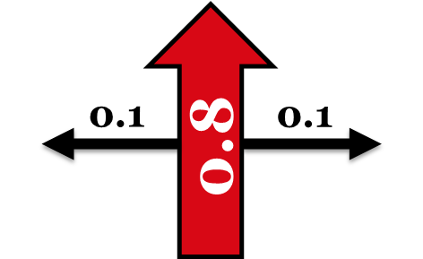
Markov Decision Process (MDP)
MDP is now built around transition model: T(s, a, s’)
Similar to existing state transition, but now encodes P(s’|s, a)
But how can we then determine value of an action against the probability distribution?
We will need a utility function, that will help calculate this based on state rewards.
A_{up} 0.1
A_{down} 0.8
S₁
S₂
S₂
A_{up} 0.8
S₃
S₁
S₃
A_{up} 0.1
A_{down} = 0.2
Notes:
So now we have our MDP which is build around modelling transition probabilities for a given state and a given action.
Hence we can now encode P, which is the probability of whether we can reach s’, in state s, using action a.
But just knowing that a probability distribution occurs doesn’t given us any real idea of just how valuable that action is. So the issue now is that calculating a heuristic that estimates goal distance isn’t of much use to us.
Why is this? Well, our heuristics have historically told us this is how far this state is from the goal. But what use is that information to us if we can’t guarantee that taking action to reach that state is going to work?
What our heuristic tells us is if we apply this action, then this is how good the state will be for us. But if we can’t guarantee that we reach that state, we really need another mechanisms.
Hence we rebalance the problem space on its head and instead start encoding the ‘reward’ of an action, such that, through experimentation we can learn how good this state and the possible actions are for execution.

Slide 15
MDP Example
We now encode a reward for each state.
Total utility of the agent is the sum of all rewards from all states visited.
Assuming our original solution
Up, Up, Right, Right, Right
(5 x -0.04) + 1 = 0.8
Negative reward incentivises optimality.
-0.04
-0.04
-0.04
-0.04
-0.04
-0.04
-0.04
-0.04
-0.04
Notes:
So if we were to apply this to our example, we’re going to now encode the states with reward values. We then hope to achieve the maximum utility, which is going to be sum of all rewards as we reach the goal based on the actions that we took and the states we were in.
Like we said earlier, the rewards are going to help incentivise us to make good actions. This actually completely removes the notion of cost of actions to get to the goal state, but that is something than can with some effort be encoded into the reward values for a given state.
In this case, we’ve set the reward values as -0.04 for every single state. We don’t have to make these rewards uniform, but for the sake of the example we’re going to keep it really simple. Although later in these slides I’m going to change the reward values given this will influence how we solve the MDP.
If we assume the original optimal solution from start to end, then we can say that the utility value of that resulting plan is 0.8, given we earned 1.0 for reaching the goal and then were penalised a total of 0.2 by starting in a state with a reward of -0.04 and then visiting four more states on the way to the goal.
Now you will have noticed, I made all the rewards negative. Why would you do that? Well if we made the rewards positive there is no real incentive to reach the goal. If positive rewards are always given and the system is told to maximise the utility, then it would simply go on random walks that avoid the goal states. So instead, by making the rewards negative we reinforce the need for optimal solutions, given the more actions taken, the greater the overall penalty in the utility function.

Slide 16
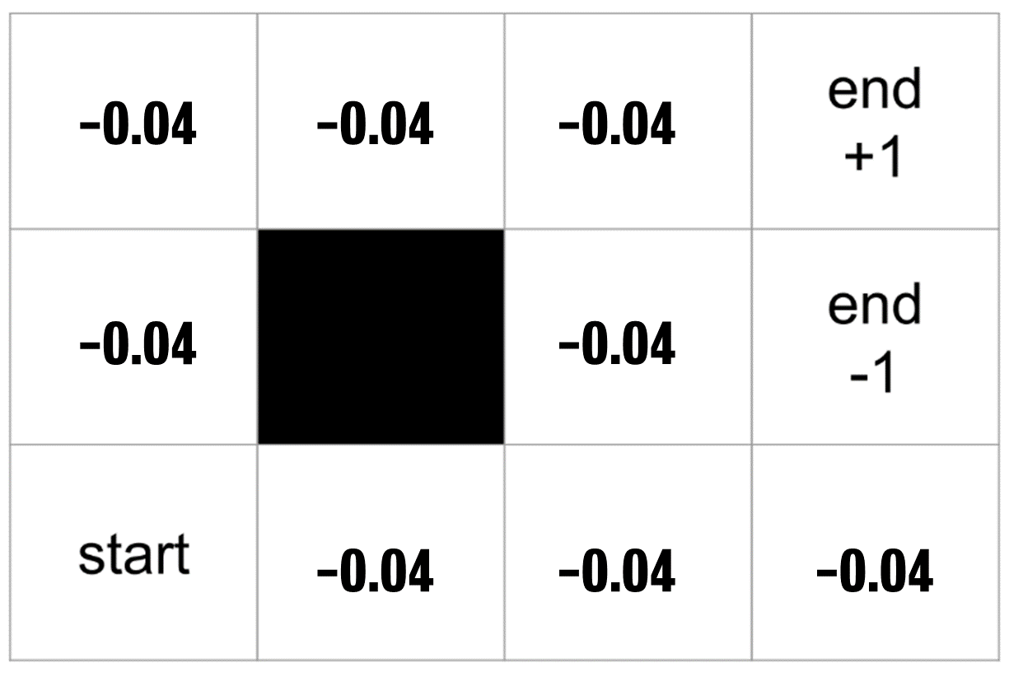

Markov Decision Process (MDP)
MDP components for all states $s ∈ S$
Transition Model: $T(s, a, s’)$
Initial State of the Problem: $s0$
Reward Function for a given state: $R\left(s\right)$
Notes:
So now we have our MDP which is build around modelling transition probabilities for a given state and a given action.
Hence we can now encode P, which is the probability of whether we can reach s’, in state s, using action a.
But just knowing that a probability distribution occurs doesn’t given us any real idea of just how valuable that action is. So the issue now is that calculating a heuristic that estimates goal distance isn’t of much use to us.
Why is this? Well, our heuristics have historically told us this is how far this state is from the goal. But what use is that information to us if we can’t guarantee that taking action to reach that state is going to work?
What our heuristic tells us is if we apply this action, then this is how good the state will be for us. But if we can’t guarantee that we reach that state, we really need another mechanisms.
Hence we rebalance the problem space on its head and instead start encoding the ‘reward’ of an action, such that, through experimentation we can learn how good this state and the possible actions are for execution.

Slide 17
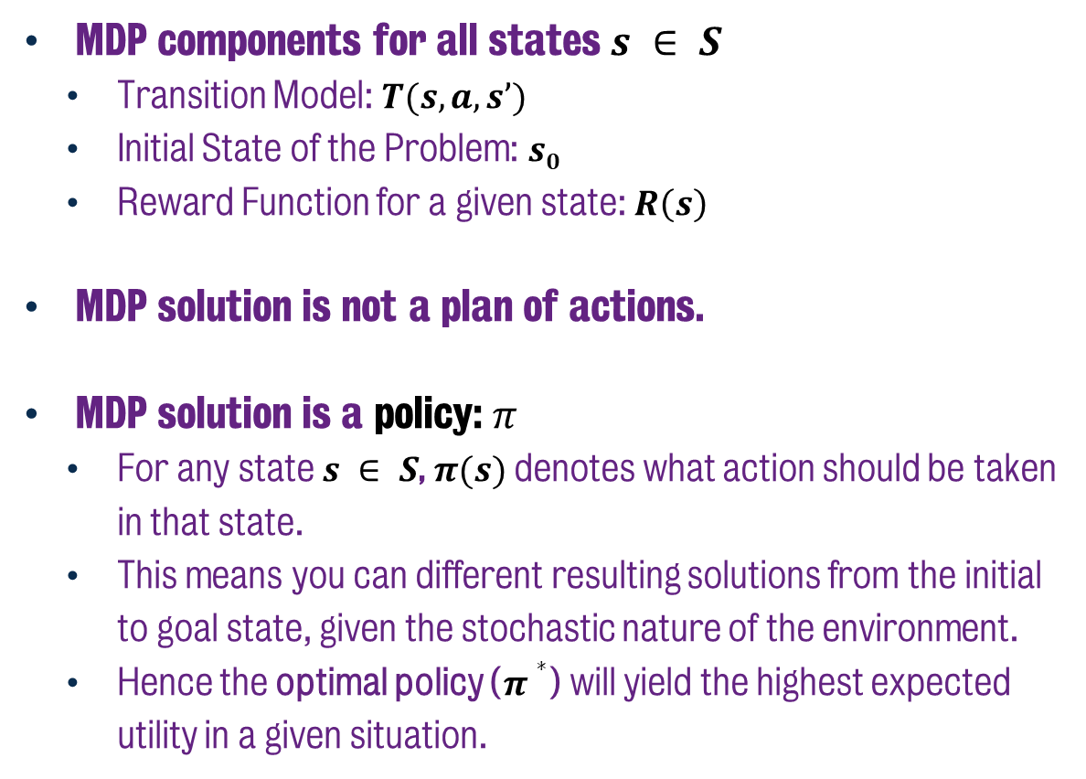
Markov Decision Process (MDP)
MDP components for all states $s ∈ S$
Transition Model: $T(s, a, s’)$
Initial State of the Problem: $s0$
Reward Function for a given state: $R\left(s\right)$
MDP solution is not a plan of actions.
MDP solution is a policy: $π$
For any state $s ∈ S$,$π(s)$denotes what action should be taken in that state.
This means you can different resulting solutions from the initial to goal state, given the stochastic nature of the environment.
Hence the optimal policy ($π∗$) will yield the highest expected utility in a given situation.
Notes:
In addition, the solution to the MDP is no longer a set of actions that comprises a plan, why?
Well, if we consider that previously we could say with confidence that the plan is – in this case – Up, Up, Right, Right, Right, that was all based on the idea that the actions were deterministic.
But, as I mentioned already, the actions are not deterministic anymore, hence that plan only has a success rate of around 1/3. So that can’t be our solution given we don’t know if that plan is actually going to work.
Instead, we need to find a means by which to say that regardless of what state we’re in, which we might reach due to the low probability of unintended action execution, that we know where to go and how to act.
Hence the solution to an MDP, is a policy, typically denoted as pi.

Slide 18
MDP Example
Optimal policy attempts to balance the risk against the reward.
Results in actions that will yield the best utility regardless of how successful we are in execution.
Highly sensitive to the action probabilities.
Notes:
So with that in mind, what does the optimal policy look like for this problem that I put in front of you?
Well the diagram on the right, shows the optimal policy, specifically denoting which actions should be executed in each state.
This policy ensures that – given the probability distribution of these actions – that we will yield the best utility in this example. This means that in the bottom right, we actually go left. This is actually because the bad goal state which is the -1 rewards, is really undesirable. The policy is highly sensitive to the fact that the action probabilities could in some cases result in a bad outcome. So while it is still taking risks on the right hand side, it’s trying to mitigate it as much as possible.
It’s really all about striking a balance between the rewards we can gather and the risks that will emerge in the world as we try to solve the problem.

Slide 19
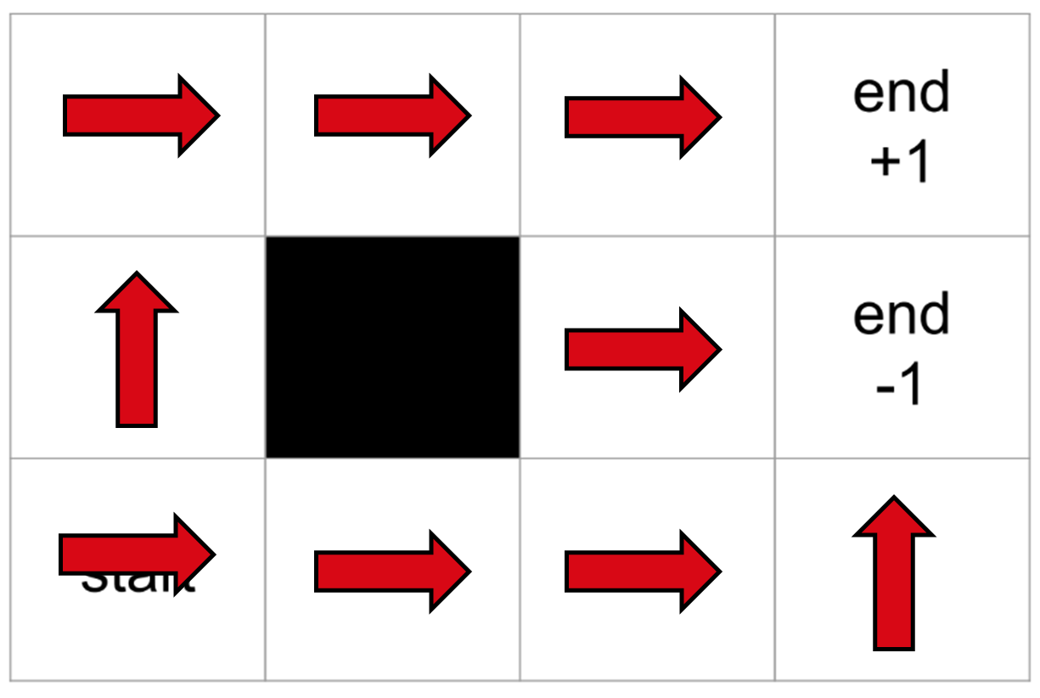
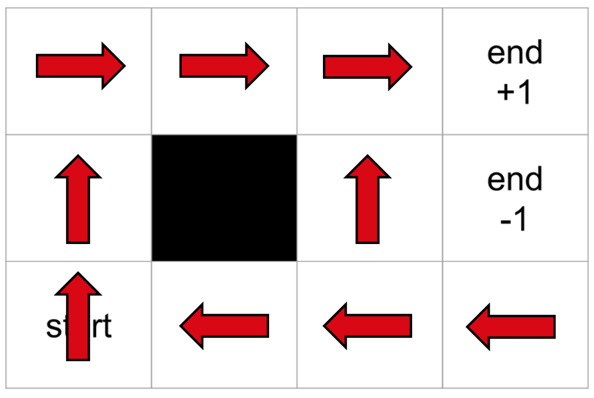

MDP Example
R(s) = -1.65
R(s) = -0.04
R(s) = -0.01
Notes:
And balancing between the risk and the rewards means that the optimal policy changes quite drastically depending on the rewards being attributed to each state.
As we can see in the bottom right, this is the example we had already. But if we change it such that the rewards are much more negative, such as that seen at the top, then it means that the optimal policy is just to get the hell out of there.
It’s even encouraging reaching the goal state with the negative reward of -1 given that is a better option than staying in the environment and yielding further negative reward of -1.65. It’s actually better just to get out as soon as possible.
However, if we then look at a smaller negative reward of -0.01, the optimal policy is even more risk averse, and opts to stay away from the negative goal state. To the point that the state to the left of the negative goal has an optimal policy of moving into the wall and hoping that the action probability will result in the agent going up or down, given simply absorbing the negative reward on each time step is better than running risk of accruing the negative 1 reward.

Slide 20
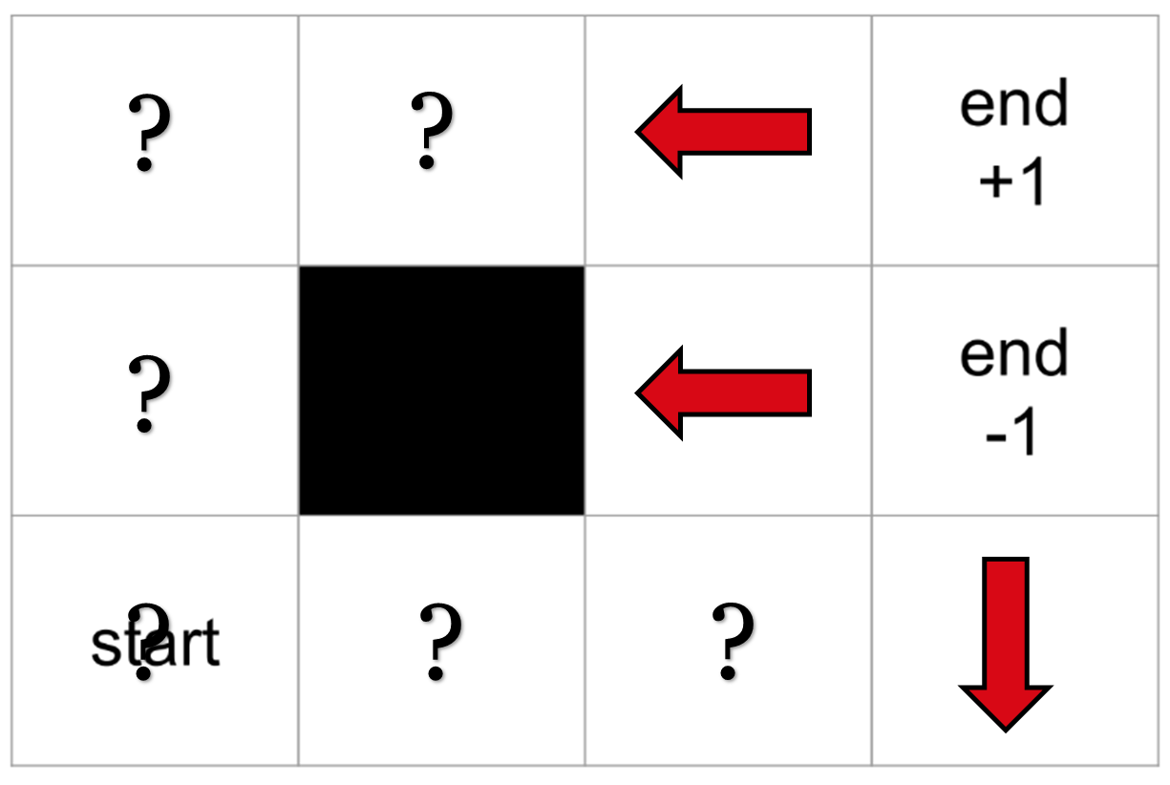
MDP Example
?
?
?
R(s) > 0
?
?
?
Notes:
And of course, if the reward is positive, then it will never want to leave and actively avoids the goal states.
In this example, I’ve denoted a question mark to simply say do any action, just randomly pick one. It doesn’t matter, because ultimately there is reward! Excellent.
This is why the rewards are typically denoted as negative in these problem spaces.

Slide 21
Markov Decision Process (MDP)
We use alterative approaches to solve MDPs.
Value Iteration
Policy Iteration
Linear Programming
Planning Under Uncertainty holds provided we have this complete model.
i.e. The transitions, reward functions and fully-observable states.
When one or more are not available, this becomes a reinforcement learning problem (model free).
Need to interact with the environment to learn these features.
Notes:
And so as we wrap up this chapter, I wanted to talk about how you could solve these problems.
In short, none of the methods we’ve discussed in the class are actually going to be able to solve the problems we’ve prescribed in this session.
We have to solve it in a rather different way, notably through use of techniques such as value iteration, whereby we compute the value of a state by repeatedly executing actions to see how viable they are in reaching the goal. The value of a state is computed as the average sum of rewards to attain from that state. Essentially if we figure out what states yield the highest value, then our optimal policies will follow the best values of states through the problem space.
However, one notable aspect that this is all driven by the fact that we have access to the state transition system, we know the reward values and the states are fully observable.
So even this is an ideal scenario, given in many problems, we don’t know what these rewards are for certain, or the probabilities of actions succeeding are also unknown. This is where reinforcement learning comes in – and if you have studied this problem area much of this will be familiar to you. There is essentially a point where problems we may conceive as planning problems can suddenly become reinforcement learning problems,
A reinforcement learning algorithm can prove useful in this case given we need to continually iterate to learn the model and from that we can continue to derive the value of states over time.
In fact if you study reinforcement learning, you may have observed that there is significant overlap with the solving of MDPs using value iteration. That’s because so much of reinforcement learning is derived from these principles. And all the examples I’ve shown in this session are used to teach foundational principles of reinforcement learning.
But the emphasis for me today was to express how different the situation becomes when uncertainty is injected into a problem. It breaks everything we’ve worked on to date and relies on different AI techniques to solve it.

Slide 22
Classical Planning
Planning Under Uncertainty
Markov Decision Process
6CCS3AIP – Artificial Intelligence Planning
Dr Tommy Thompson
Notes:
Thanks for watching this introductory video on MDP’s and the idea of planning under uncertainty. Catch you in the next one!

